Slide 1
The Great @fsibot Caper

Slide 2
Chapter 1
Genesis

Slide 3
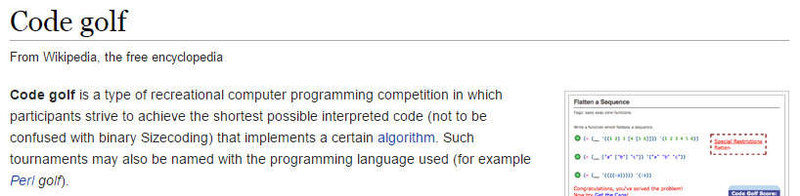

Slide 4
Happy Birthday to you…

Slide 5


Slide 6
Chapter 2
Foundations

Slide 7
Microsoft (R) F# Interactive version 12.0.30815.0
Copyright (c) Microsoft Corporation. All Rights Reserved.
For help type #help;;
> “I’ve still got the greatest enthusiasm in the mission.
And I want to help you.” |> sprint “%s”

Slide 8
Twitter
Read mentions
Evaluate expression
Compose response

Slide 9
plz send the codez
fsibot, take 1

Slide 10

Bits & Pieces
Linq2Twitter
TopShelf
Azure VM
F# Compiler Services

Slide 11
F# Compiler Services
Exposes F# compiler and extensions
Powers many F# open source projects
PowerTools, IDEs/editors, fsReveal, …
http://fsharp.github.io/FSharp.Compiler.Service/

Slide 12
[ Demo time! ]

Slide 13
@djidja8: chess
@functional_S: smoke
@ptrelford: cards shuffle
@mavnn: quotations
@tomaspetricek: x-mas
@blaise_v: pi
@brandewinder: F#

Slide 14
Chapter 3
P0wnage

Slide 15
What could possibly go wrong
with letting people run arbitrary code
on my machine?
(After all, it’s only 140 characters…)

Slide 16
Wednesday, August 27, 2014
“The Day of Great P0wnage”

Slide 17
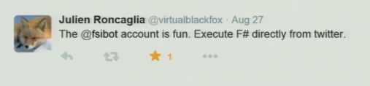

Slide 18
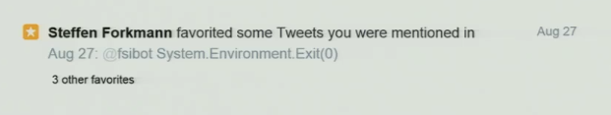

Slide 19
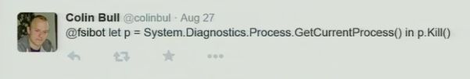

Slide 20
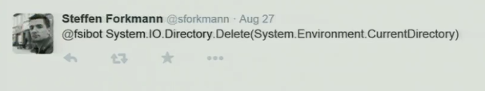

Slide 21
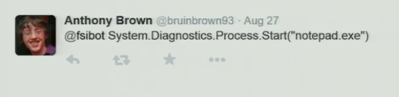

Slide 22
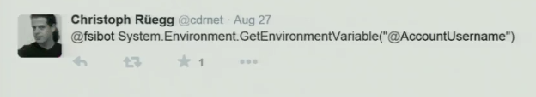

Slide 23
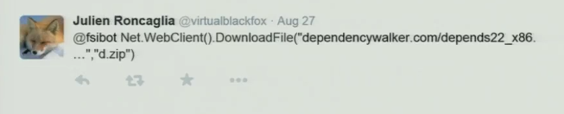

Slide 24

The more successful
the villain, the more
successful the picture.
A. Hitchcock

Slide 25
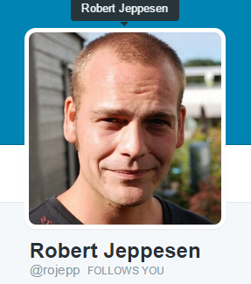

Slide 26
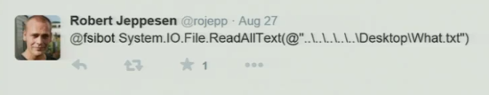

Slide 27
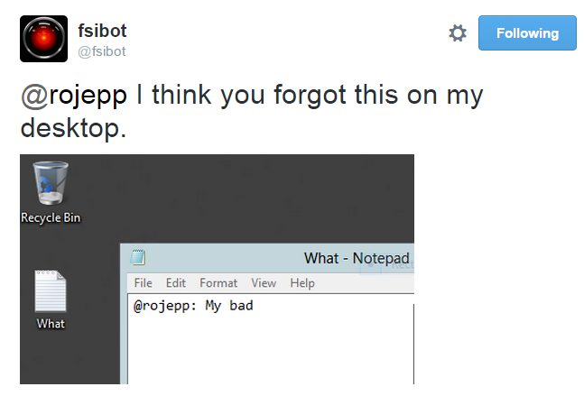

Slide 28


Slide 29
Chapter 4
Containment

Slide 30
Twitter
Read mentions
Evaluate expression
Compose response

Slide 31
Twitter
Read mentions
Azure Service Bus
Evaluate expression
Compose response

Slide 32
[ Interlude: creating a queue ]

Slide 33
Code like you think
fsibot, take 2

Slide 34
Azure Service Bus
Now 100% more Enterprise!
Dead simple to use
Solved 80% of the issues
Duplicate detection

Slide 35
Chapter 5
Security

Slide 36
Suspicion
System.IO
System.Net
System.Threading
…

Slide 37
Epilogue
I for one…

Slide 38
Lessons learnt
Security is hard
Making your code public spices things up
Lots of power in 140 chars of F#...
Compiler Service is surprisingly easy
Azure Service Bus / queues are great

Slide 39
What’s next?
Quines?
Charting? Data? [Wolfram Bot]
Sessions?
Hook to StackOverflow, Slack?
… let me know ☺

Slide 40
Credit / huge thanks to
@tomaspetricek
@rojepp
@panesofglass
… also @bbqfritto, @ptrelford, @pblasucci, @rickasaurus, @relentlessdev…

Slide 41

Ping me! @brandewinder

